Slide 1
Unix System Administration
Unit 3:
  Run levels
  Installing software
  Modifying kernel

Slide 2
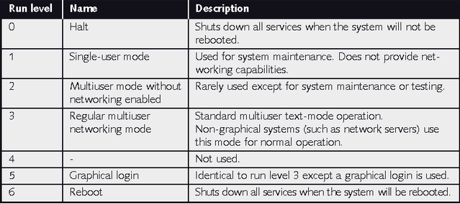
Run Levels

Slide 3
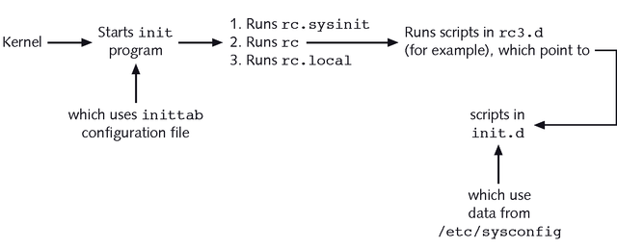
Linux Initialization Process

Slide 4
Service configuration
/etc/rc3.d or /etc/rc5.d
  scripts starting with S to start service
  scripts starting with K to stop service
/etc/init.d
chkconfig
  add service
  turn service on/off in run level
service
  start/stop/restart utility

Slide 5
Changing run level
init
  Command to change run level
halt, reboot
shutdown
with delay and message to users

Slide 6
Installing software
yum
via rpm command
  install, update and query options
tarball
  collection of files in compressed tar archive
    use tar xvf command to extract
check /usr/share/doc directory
  read INSTALL or README files

Slide 7
The Linux Kernel
released by Linus Torvalds in source code
  ftp.kernel.org
current release number: 3.9rc3
obtain and prepare kernel source code
  http://wiki.centos.org/HowTos/I_need_the_Kernel_Source

Slide 8
Linux Kernel components
Linux executable
  bzImage or vmlinuz
Modules
  kernel code that can be loaded/unloaded
  stored in /lib/modules
  module utilities
    lsmod
    insmod, modprobe
    rmmod

Slide 9
Kernel customization
customize kernel options
  make xconfig
    may require qt-devel package
  make menuconfig
compile kernel
  make bzImage
  make modules
install
  make modules_install
  make install
check boot loader configuration
  install on boot sector: grub-install

